Slide 1
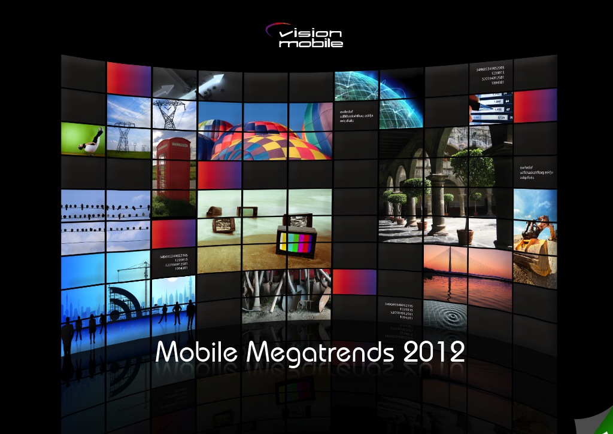

how telecoms business is transforming in the software era Updated 12 Oct 12
how telecoms business is transforming in the software era Updated 4 May 2012
Copyright VisionMobile 2011

Slide 2

Knowledge. Passion. Innovation.
Andreas Constantinou
Michael Vakulenko
Stijn Schuermans
Matos Kapetanakis
(c) VisionMobile 2012

Slide 3
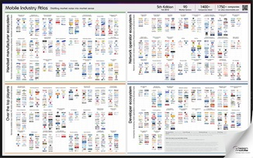


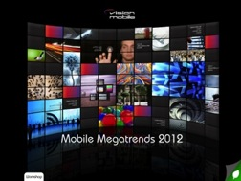
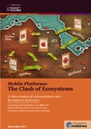

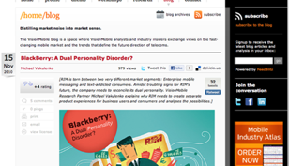


VisionMobile
Distilling market noise into market sense
Research
competitive analysis, commissioned research
Workshops
mobile industry dynamics
for telcos and OEMs
Market maps
Competitive landscape maps
Strategy definition
strategy design, ecosystem positioning, product definition
Developer Economics 2011: How developers and brands are making money in the mobile app economy
Mobile Innovation Economics
how Internet business models are impacting telecoms and how to innovate in the age of software
Mobile Industry Atlas, 5th ed.
1,700+ companies, 90 market sectors
Mobile Megatrends series
Following and analysing major trends in mobile
Clash of ecosystems
mobile platforms and the battle for dominance
HTML5
and its impact to the mobile industry
Top-100 analyst blog
4,000+ subscribers
20,000+ monthly uniques
90% mobile industry insiders
The Android Game Plan
the commercial mechanics behind Android and how Google runs the show
100 million club
tracking successful businesses in mobile
3

Slide 4
Trusted by industry brands
Clients
selected
VisionMobile clients
2008-2012

Slide 5









Mobile Megatrends 2012
Handset DELL-ification and the emerging pyramid of handset OEM
Web as the new walled garden and why web is waiting for a new leader
Cross-platform tools
the next challenge to the Apple/Google duopoly
The Kindelization of tablets how Kindle is setting the rules of the tablet market
Ecosystems battle across 4 screens Experience roaming drives user lock-in, cross-sales and engagement
Accessories the next frontier for platform differentiation
Tools for gold seekers
The developer gold-rush has led to a gold rush for developer tools
Reinventing the telco
Unbundling the telco to compete in the software era
The future of voice
From telephony to diversity of use cases

Slide 6

Handset DELL-ification
and the emerging pyramid of handset OEMs

Slide 7
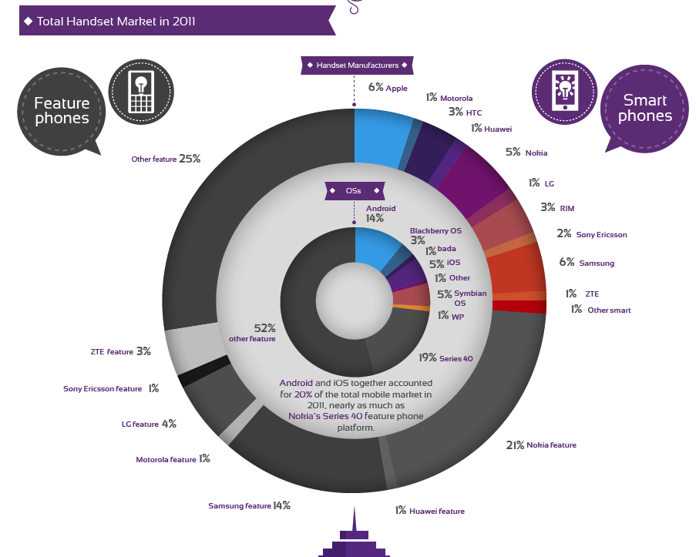
The complex picture of the mobile phone market But mobile phone market share doesn’t tell the full story
Source: VisionMobile

Slide 8
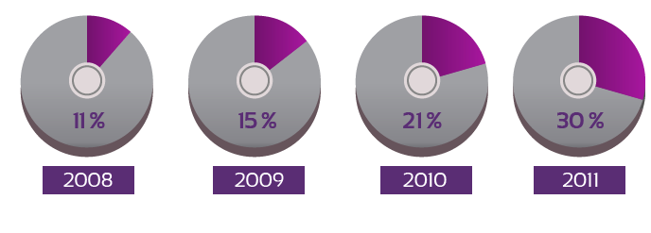
Smartphones reached 30% market share in 2011 483M units shipped worldwide
Smartphone shipments as a % of total handset shipments
Source: VisionMobile

Slide 9
Smartphone sales vary greatly by region Q2 2011 are the majority of handset sales in North America (63%) and Europe (51%)
Market share
Source: VisionMobile

Slide 10
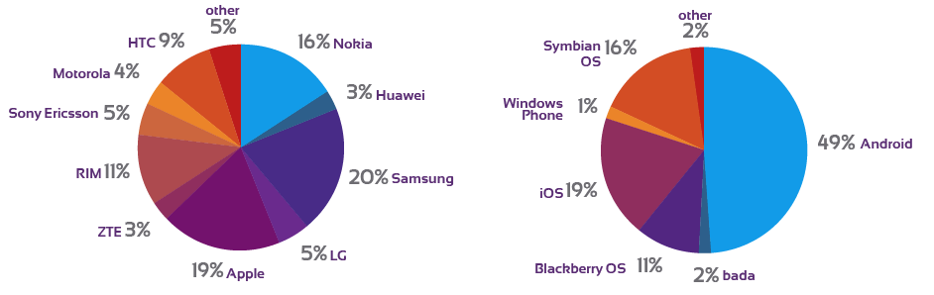

Android became dominant smartphone OS Samsung and HTC benefited the most from Android success (Q4 2011)
Smartphone market share by OEM and platform (H2 2011)
Source: VisionMobile

Slide 11









Android turned the tables on handset makers Samsung and HTC benefited, Nokia, Motorola, Sony were challenged
Beneficiaries:
fast-moving challengers
Efficient cost structure plus ability to differentiate
in software, hardware or both
low cost assemblers
Cost structure optimised for razor-thin margins
Android is a long-term opportunity for global reach
Under pressure:
‘old guard’ OEMs
Cost structure requiring high-margins
Commoditising effect of Android makes high-margins unattainable for OEM without own ecosystem or meaningful differentiation
Sold
Restruc-tured
Turn-around?
No Name
source: VisionMobile

Slide 12


Profits are monopolized by companies with a tailored value-chain
Commodity modular market
Integrated from cloud to silicon
Integrated across handset BoM
Share of profits across top-8 handset vendors. Source: Asymco, VisionMobile estimates
Notes:
>>> added diagram from Mobile Insider

Slide 13
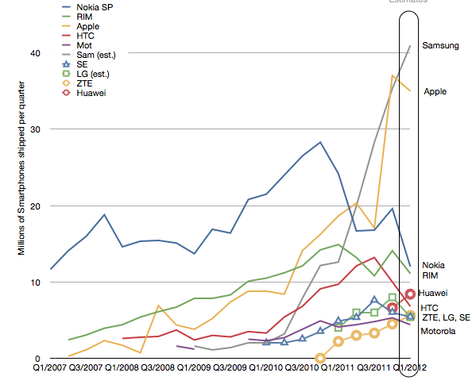
Tailored value chain leads to hyper growth Healthy profits allows to invest more in innovation, product development and marketing
Estimates
2 players dominate smartphone shipments
10 OEMs with more than 2% market share
Source: Asymco
Notes:
>>> updated title styling

Slide 14




Modular value chain leads to a disadvantage OEMs with closed or tight integration are at a competitive advantage
Core business | Device sales | Device sales | Device sales | Device sales
Software | Closed | Modular | Modular | Modular
Hardware (processors, memory, displays) | Semi-closed | Semi-closed | Modular | Modular
Handset design | Closed | Closed | Closed | Closed
Competitive advantage due to tailored value-chain
Commoditization pressure due to modular value-chain
Notes:
Apple is semi-closed around hardware as it buys displays from Samsung, but owns the chipset IP
Samsung is semi-closed around hardware is it uses both own components and competitor components
Competitive advantage is in terms cost (and thereby profit margins), availability (e.g. of latest screens), time to market, ability to innovate independently of suppliers

Slide 15





Innovate, follow or assemble The ladder for OEMs in the post-Android era
1. Innovators: Unique product experiences at premium price
Companies that can masterfully integrate hardware + software + services + ecosystems into unique product experiences - from phones and tablets to TVs.
2. Fast followers: Differentiated product experiences
Propelled by Android growth - Build strong brand and differentiation on top of Android ecosystem.
3. Assemblers: Me-too products competing on price
10s of assemblers use Android to deliver ready-to-market smartphones with complete service and apps ecosystem competing head-to-head with major OEMs.
4. Mass producers of feature phones: catering to developing markets
Rely on huge economies of scale to break even at $50, but make up nearly 60% of unit sales in the mobile handset market.
No Name
Notes:
>>> Updated title

Slide 16
DELL-ification and the new roles of OEMs The pyramid structure of OEMs in 2012
Profit pyramid
Revenue pyramid
unique experiences
Innovators
Role model:
exceptional margins
attractive margins
meaningful differentiation
Fast followers
Role model:
1.7B devices
low margins
Assemblers
Role model:
compete on price only
low margins
Feature phones
Role model:
nearly 60% of sales compete on price only
Source: VisionMobile

Slide 17


Redrawing the map of handset competition 2005 - 2012
Profit pyramid
Revenue pyramid
exceptional margins
unique experiences
attractive margins
meaningful differentiation
1.7B devices
low margins
compete on price only
60% of sales compete on price only
low margins
Source: VisionMobile
Notes:
>>> Added RIM

Slide 18
Competing in the era of DELLification Key lessons for the era of assemblers and price competition
- The basis of competition is the size of the ecosystem
Apple changed the basis of competition in mobile phones; from features to experience and from number of handsets to number of apps. Besides iOS and Android, others struggle to compete.
- Android caused market concentration to plunge
The amount of handset makers with more than 2% global market share went from 6 to 10 in two years time.
- Only way to make profits with Android is speed and vertical integration
Android OEMs are in a “race to the best device”, a race which cannot be won. Samsung’s basis for profitability is a uniquely tailored value chain; Samsung makes its own screens and chipsets which allow it capture profits across the value chain. It also has the fastest time to market for new Android handsets.
- RIM, Nokia, Sony need to adapt to the new game rules
RIM lost because their unique product proposition was replaced by alternatives (Gmail, WhatsApp)
Nokia is challenged because it modularised both software (WP7) and hardware, which compromised by value chain profits and timeto market. Sony needs to turn handsets into a either a profit-making division or a loss-making complement to the content business.
Notes:
>>> Added slide

Slide 19
“Apple & Samsung’s Profit Recipe-garden“ Research note published as part of the VisionMobile CEO Trendwatch service trends@visionmobile.com
want more?

Slide 20

HTML5: Web as the new walled garden
and why the web is waiting for a new leader

Slide 21
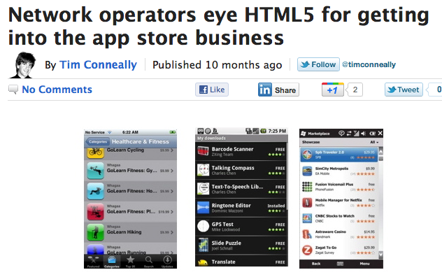
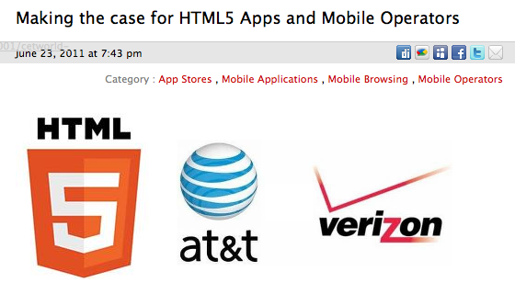
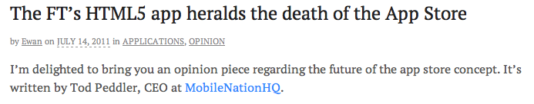
HTML5 is pitched as the future of mobile apps

Slide 22


…but what is HTML5, really?
A set of browser specs by 2 standard groups: W3C and WHAT
WHAT WG - Web Hypertext Application Technologies
The WHAT working group specs merge into W3C specs
Brings capabilities of web apps closer to those of native apps
UI tools, off-line storage, 2D graphics, plugin-free video/audio
geo location, speed and communication
Notes:
T1 telco: HTML5 is seen as the panacea to all our problems

Slide 23
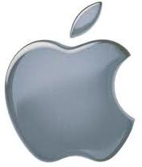







Many benefactors, but no clear leader all pushing and hyping HTML5 for their own unrelated reasons
Apple looking to move the web away from Flash
Google searching for more ways to commoditize complements
Facebook aiming to break-down Apple/Google silos and distance Adobe
Microsoft to onboard web developers onto Windows 8
Mobile operators hoping to regain control lost to native platforms
Qualcomm aiming to create a competitive advantage for its chips
Brands looking use web as a low-cost way to go cross-device and cross-screen
Adobe aiming to sell tools that facilitate web-to-native hybrid apps

Slide 24
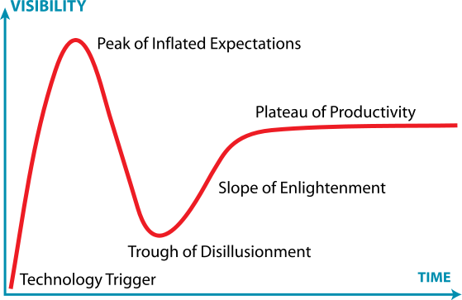
But HTML5 is just past the peak of expectations
Fragmentation across platforms (iOS, Android, BlackBerry, Windows Phone)
Challenged to compete with native user experience
Lack of distribution channels and monetisation for web apps
Source: VisionMobile

Slide 25
HTML5 is fragmented across platforms
Source: html5test.com, April 2012.

Slide 26

Andrew Betts of Assanka on app.ft.com: It took a full-time team of 3 developers at Assanka 8 months to launch on iPad, and that team a further 4 months to bug-fix the iPad and ready for distribution to Android tables.
October 2011
http://www.tomhume.org/

Slide 27
HTML5 is a technology lacking key ingredients unable to compete with iOS and Android platforms
Platform ingredients
Software foundations | Developer ecosystem | Monetisation | Distribution | Retailing
HTML5
✔ | = | ✖ | ✖ | ✖
fragmented platform
always a step behind native
complex tool-chain
will depend on app store
waiting for a leader
Facebook? Google? Other ?
islands of developers
using common language,
but different API sets
Source: VisionMobile
Notes:
>>> Slightly updated slide styling

Slide 28




Google & FB are building complete platforms adding missing ingredients on top of HTML5 enabling technology
Key
ingredients
Software foundations | Developer ecosystem | Monetisation | Distribution | Retailing
application runtime, developer tool-chain, & platform APIs | Developers building and publishing apps around the software foundation | micropayments, ad networks and settlement | app distribution to end users through SaaS or devices | app discovery, promotion, placement, search & recommendations
HTML5 browsers (fragmentation) | Fragmented | --- | --- | ---
HTML5 with Chrome API | web developers | Google Checkout | PC, Mac, Android, Chrome OS | Chrome Web Store
HTML5 with Facebook APIs | Web and Flash developers | FB Credits | 900M Facebook users | FB app recommendations
HTML5 may end up a yet another walled garden despite the promise of openness
Source: VisionMobile

Slide 29

“Web as the new walled garden“ Research note published as part of the VisionMobile CEO Trendwatch service trends@visionmobile.com
want more?

Slide 30

Cross-platform tools
The next challenge to the Apple/Google duopoly
Copyright VisionMobile 2011

Slide 31







So many platforms, so little time Developers face a real challenge making apps for multiple platforms
mobile web HTML/CSS/Javascript
Windows 8 C#, C++
Android Java
iOS Objective C
Windows Phone C#
BlackBerry OS Java, web
Bada C++
Boot2Gecko HTML5
webOS HTML5, C++
Source: VisionMobile

Slide 32


















Cross-platform tools come to rescue drastically reduce costs by code reuse and efficient developer resource management
2000
today – explosion of tools
100+ tools!
Source: VisionMobile
Notes:
- Better code reuse
cross-platform tools are proven to increase the number of platforms simultaneously catered to by developers.
Managing development resources (see report for details)

Slide 33
Mergers & Acquisitions in the CPT space
Source: VisionMobile Cross-platform Developer Tools 2012 report
Notes:
Mergers, financings and the survival of the strongest
In the CPT space we have tracked 10 acquisitions, and over US$ 200 million in funding rounds. This is a market that takes cash to survive: CPT vendors are subsidizing their entry to market with free products, based on ample VC funding

Slide 34
















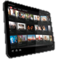












Diversity of tools catering to all use cases catering to all sorts of developers, types of apps and mobile platforms
Javascript tools
Source translators
App factories
Web-to-native
Runtimes
Source: VisionMobile
Notes:
>>> Updated styling

Slide 35



Cross-platform tools democratize development Extend the reach of masses of web developers beyond the browser
Cross-platform tools
about
300K
“Native” developers
create apps using programming languages and tools specific to platforms
Web developers
about
3 million
create apps using HTML/CSS/Javascript – less dependent on specific programming skills
Source: VisionMobile
Notes:
>>> need to get more exact numbers at a later point

Slide 36






CPTs take the web beyond browsers Combine ease of web development with advantages of native apps
authoring
packaging
discovery
delivery
native OS
HTML/CSS/Javascript
HTML/CSS/Javascript
web browser
web app
HTML/CSS/Javascript
web dev. tools
server hosting
Internet search
web browser
native wrapper
native OS
HTML/CSS/Javascript
HTML/CSS/Javascript
native wrapper
hybrid app
HTML/CSS/Javascript
web dev. tools
native wrapper
app stores
installed app
web content journey
Source: VisionMobile

Slide 37



Cross-platform tools reduce power of platforms CPTs dilute developer lock-in
platforms lock developers to users to accelerate network effects
cross-platform tools dilute developer lock-in
Source: VisionMobile

Slide 38
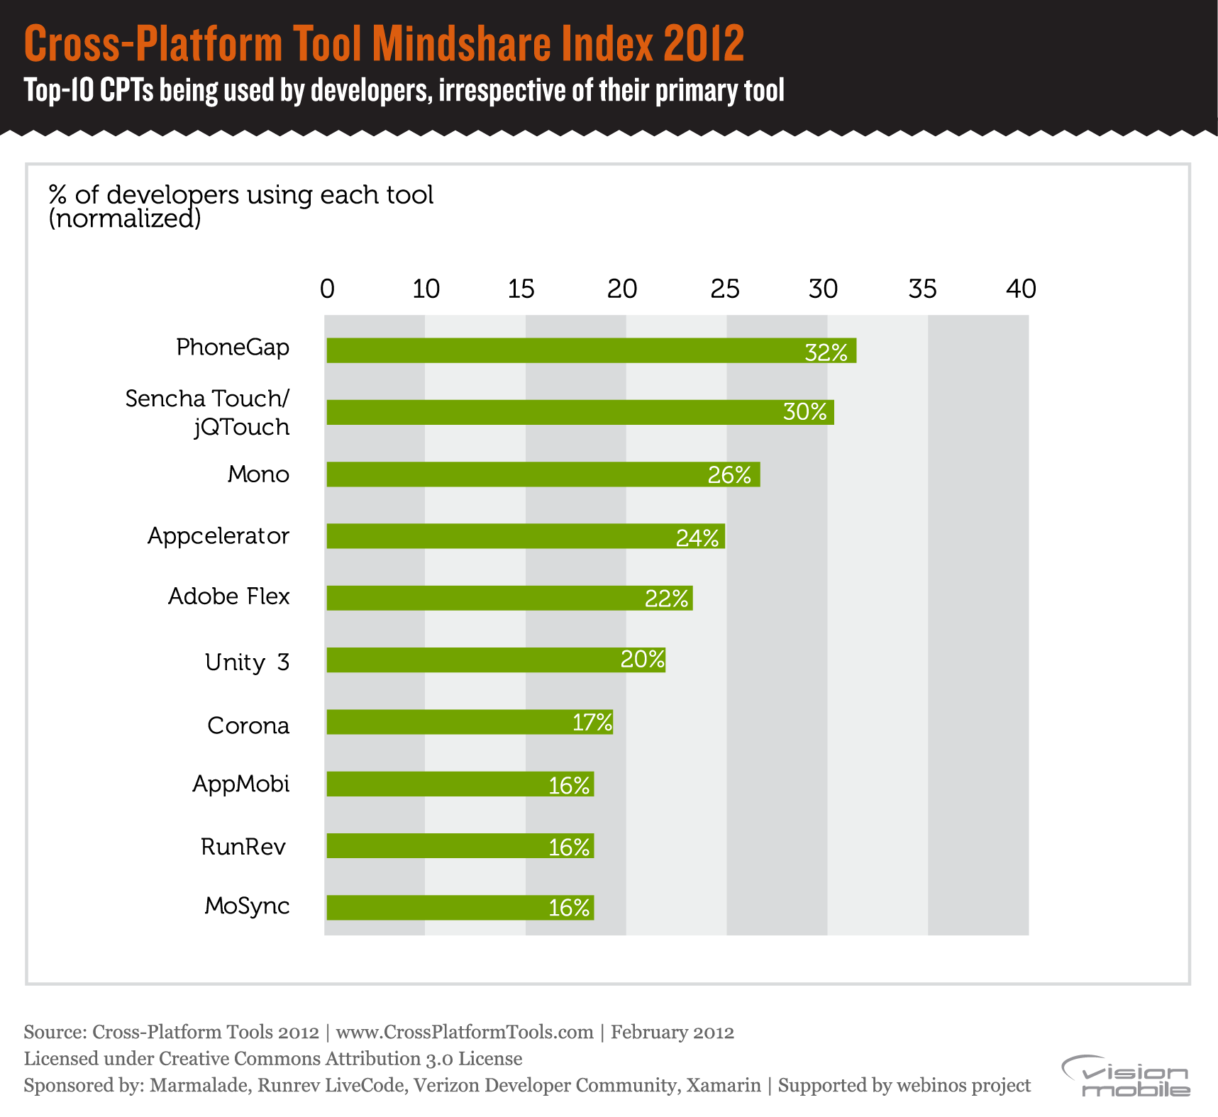

Notes:
PhoneGap and Sencha lead developer mindshare
Our survey of over 2,400 developers revealed that PhoneGap and Sencha lead in terms of mindshare, as they are currently used by 32% and 30% of cross-platform developers, irrespective of their primary tool

Slide 39
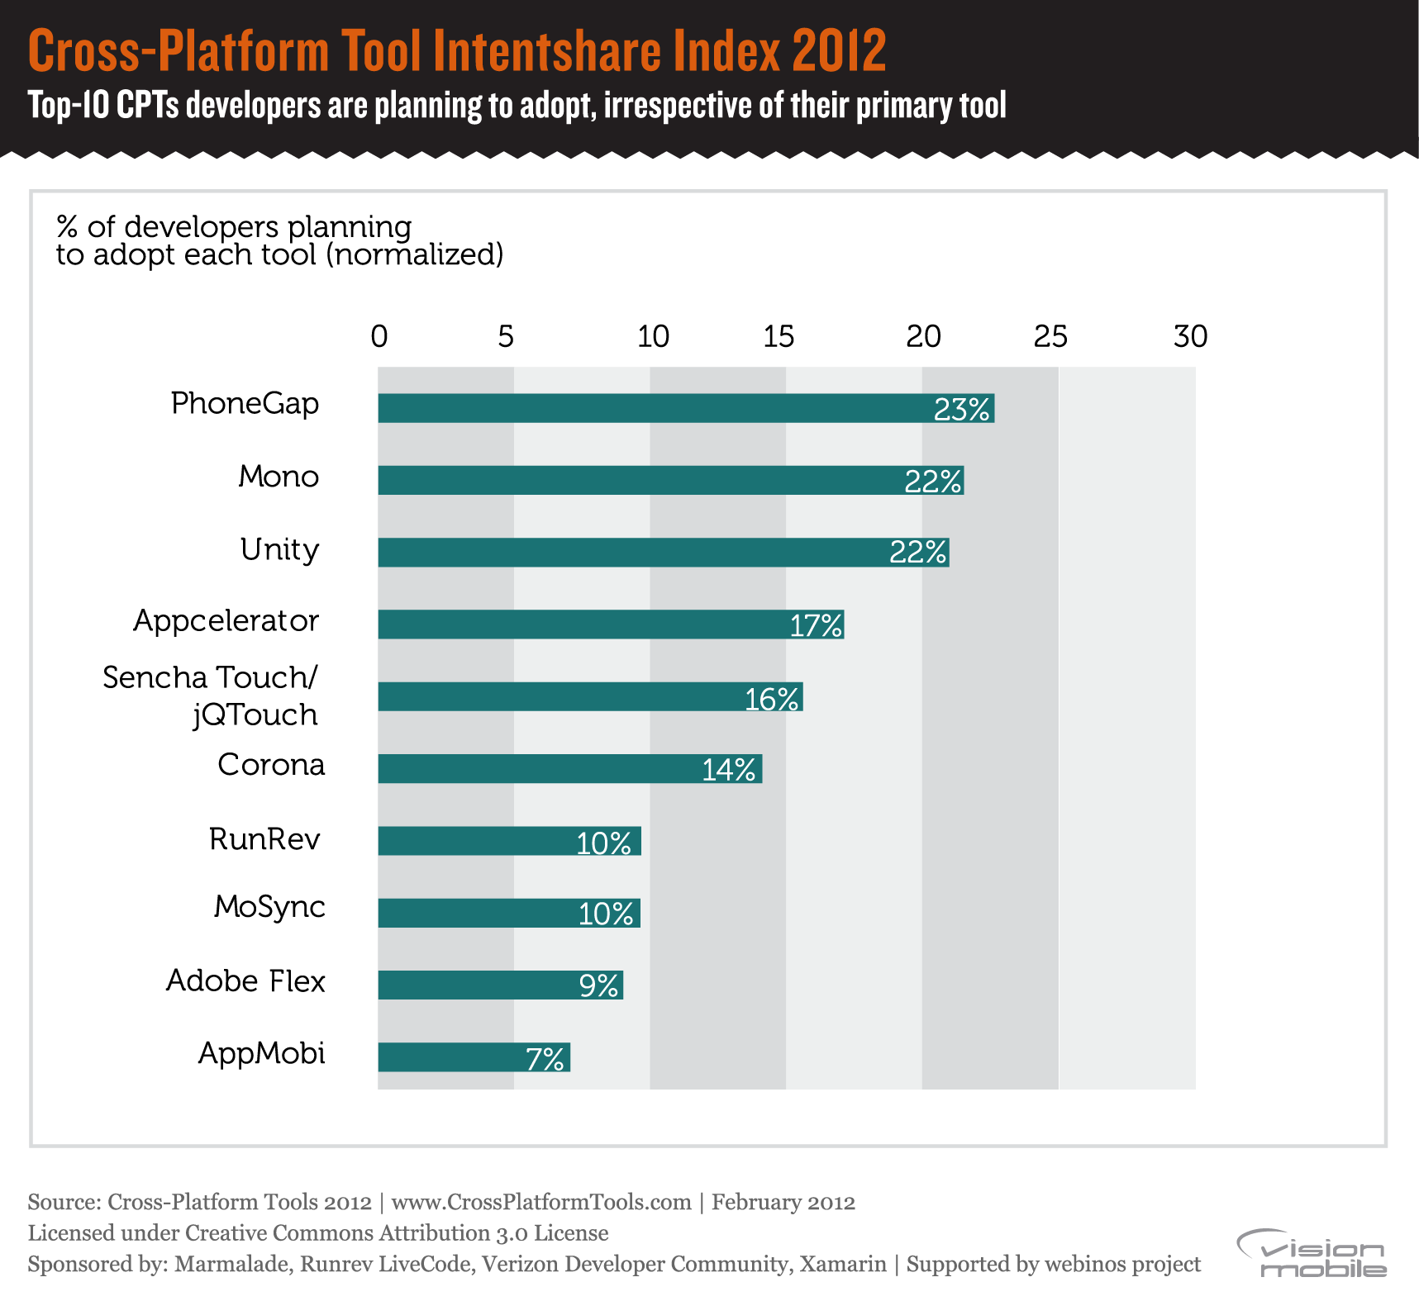
Notes:
PhoneGap, Mono, Unity lead developer Intentshare
PhoneGap (23%), Xamarin Mono (22%) and Unity (22%) are the tools most developers plan to adopt, irrespective of their primary tool. This market is in constant flux, with developers experimenting and trying out new tools – for example PhoneGap is a stepping stone to cross-platform development as it leads Mindshare, Intentshare, but also comes third in the tools being abandoned.

Slide 40

want more?
“Cross-Platform Developer Tools 2012” Research report by VisionMobile Published February 2012 free download
www.CrossPlatformTools.com

Slide 41

Tools for gold-seekers
The developer goldrush has led to a goldrush for developer tools
Notes:
>>> updated image

Slide 42
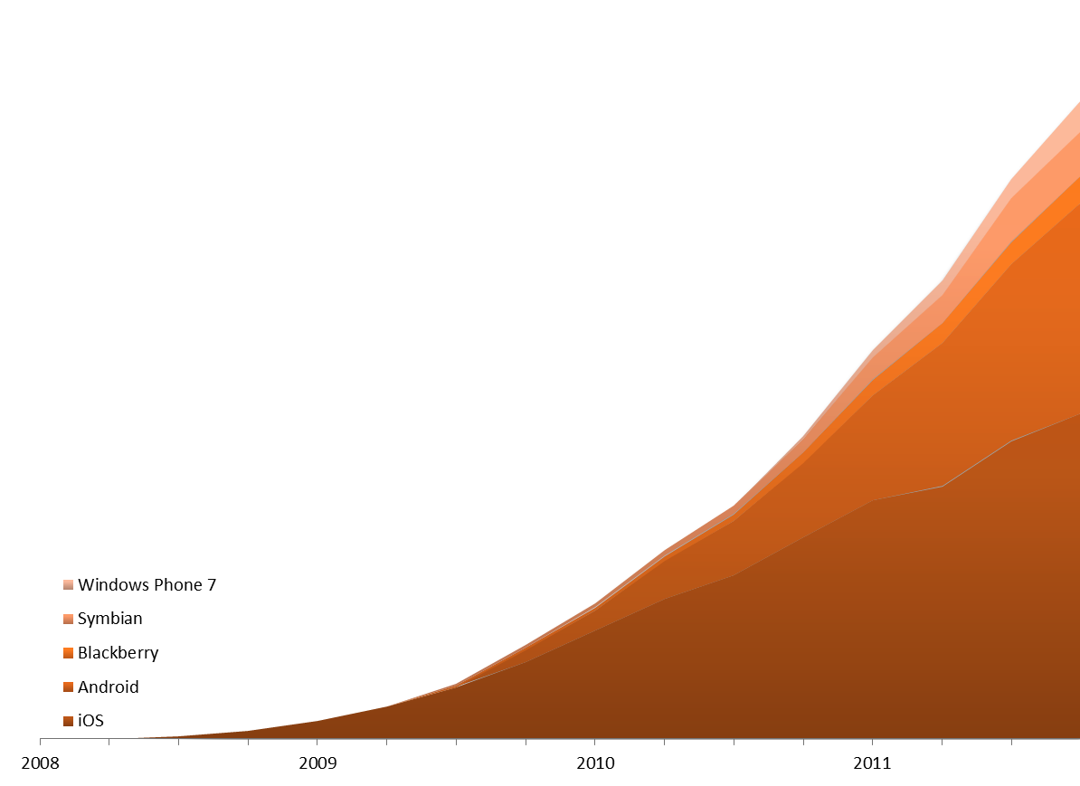

App gold rush shows no sign of slow-down with ever-growing number of apps in leading platforms
Number of apps per platform
Source: VisionMobile

Slide 43
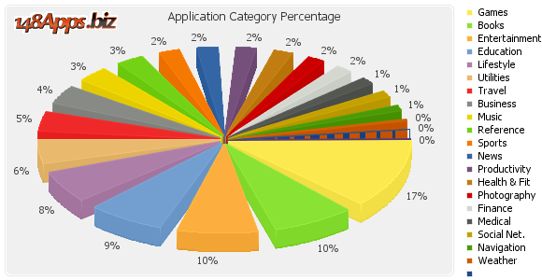
There is an app for every need and taste
Application categories as percentage of the number of iOS apps
Source: 148Apps.biz, iTunes App Store (iOS), updated 2012-03-26
Notes:
>>> updated subtitle

Slide 44
Apps is the new bubble
One million apps can’t be wrong, can they?
App developers struggle with app discovery
App stores have become a battleground for user attention
The average paid app needs about 25,000 downloads per day to reach the top 50 in the Apple App Store or the Google Play market
Oversupply de-values apps
Very difficult to make money out of apps
Apps need to move from product innovation to marketing innovation
Just like FMCGs, apps are in a mature market now
Notes:
http://www.istockphoto.com/stock-photo-19209543-burst-your-bubble.php?st=63df056
Worth adding stat about number of apps with > 50K downloads on Android from Yammer → MV: couldn’t find anything like that – do you remember where it is?

Slide 45
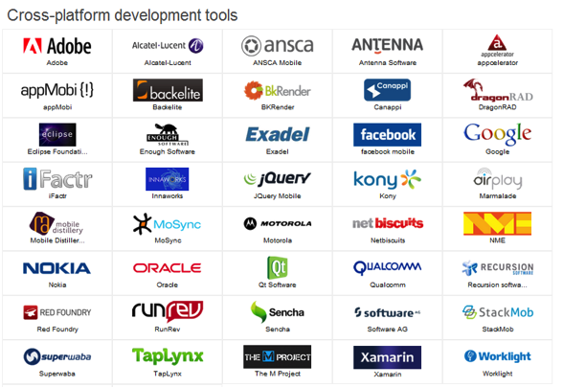
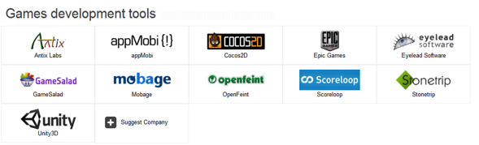
Entire B2D market sectors emerge Business-2-Developer: Selling tools to developers across all developer journey
application planning
develop &
debug
market readiness
distributiion &
monetisation
retailing & discovery
in-use
Source: atlas.visionmobile.com - now available!

Slide 46
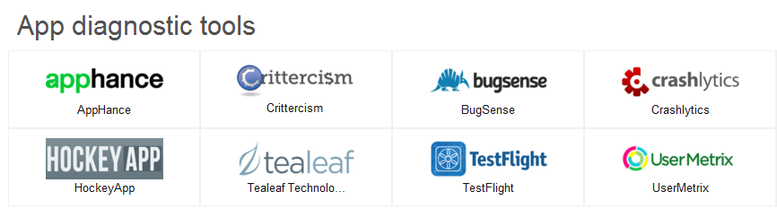
Entire B2D market sectors emerge Business-2-Developer: Selling tools to developers across all developer journey
application planning
develop &
debug
market readiness
distributiion &
monetisation
retailing & discovery
in-use
Source: atlas.visionmobile.com - now available!

Slide 47
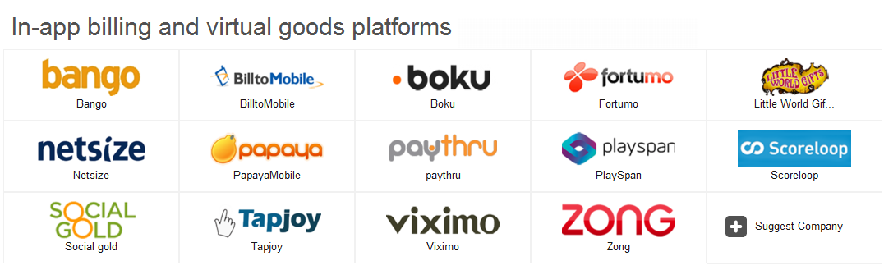
Entire B2D market sectors emerge Business-2-Developer: Selling tools to developers across all developer journey
application planning
develop &
debug
market readiness
distributiion &
monetisation
retailing & discovery
in-use
Source: atlas.visionmobile.com - now available!

Slide 48
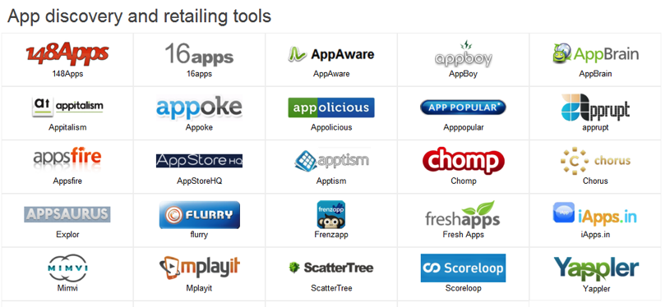
Entire B2D market sectors emerge Business-2-Developer: Selling tools to developers across all developer journey
application planning
develop &
debug
market readiness
distributiion &
monetisation
retailing & discovery
in-use
Source: atlas.visionmobile.com - now available!

Slide 49
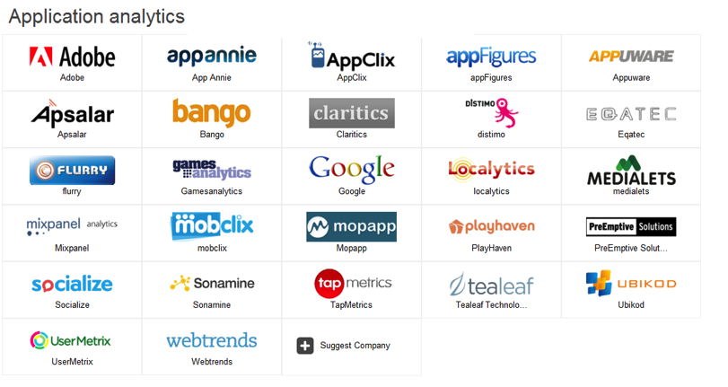
Entire B2D market sectors emerge Business-2-Developer: Selling tools to developers across all developer journey
application planning
develop &
debug
market readiness
distributiion &
monetisation
retailing & discovery
in-use
Source: atlas.visionmobile.com - now available!

Slide 50
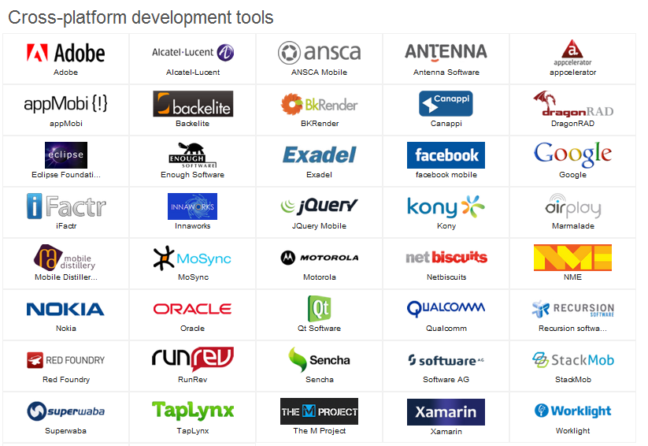


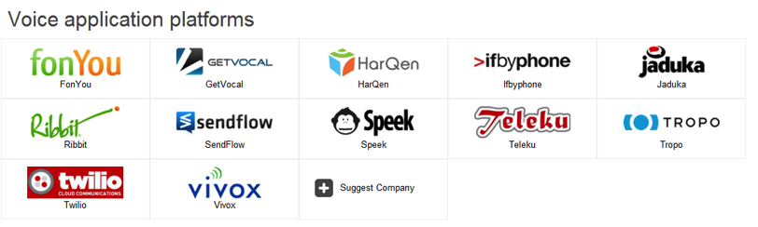
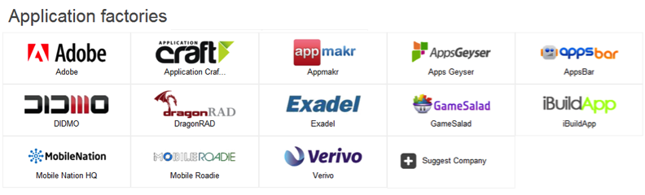

Tools for gold seekers are a gold rush by itself
Entire new market sectors are emerging
Source: atlas.visionmobile.com - now available!

Slide 51
Another bubble emerging
Tools for app developers will accelerate app development even more
Reduced barriers to entry
Making an app becomes easy, fast and dirt cheap
Again a non-sustainable market
Dog-eat-dog competition for developer attention
Expect convergence on a few tools, and consolidation
Notes:
>>> Add call to action to the Atlas

Slide 52
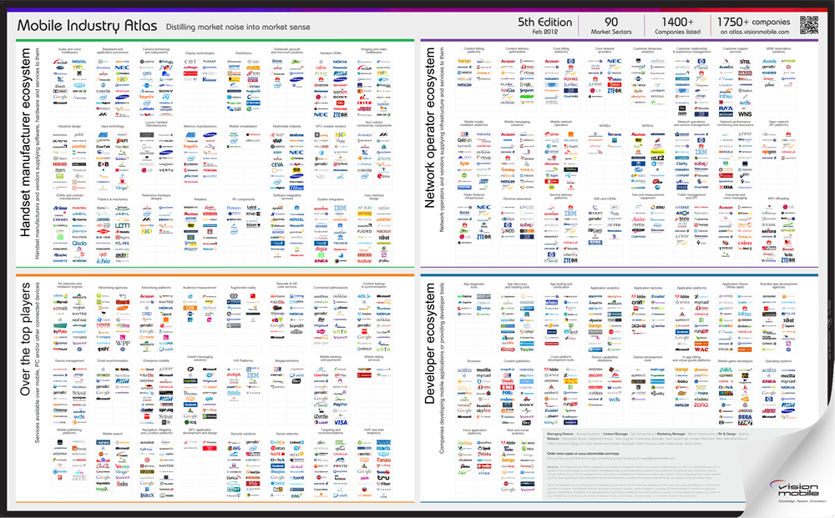
want more?
“Mobile Industry Atlas” the most comprehensive
map of the mobile industry featuring 1,700+ companies
Atlas.visionmobile.com

Slide 53

The Kindelization of tablets
How the Kindle has set the rules of the tablet market

Slide 54
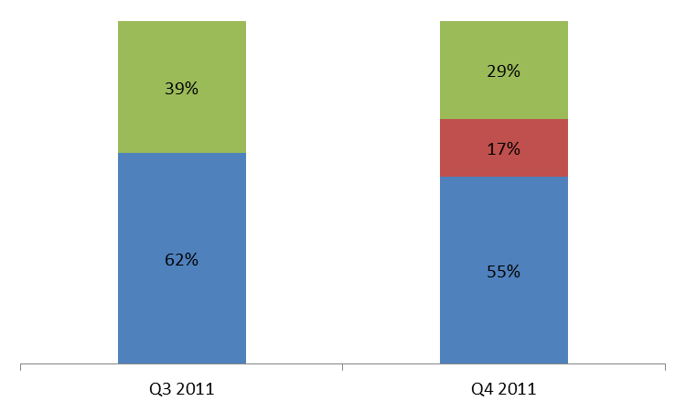


How did the Kindle stand out?
100s of iPad-clones
Kindle Fire
Two tablets took
72% market share
100s of others struggle.
What’s the magic?
Apple iPad
Global tablet market share, source IDC

Slide 55

Apple & Amazon are both “metal-to-cloud” players value proposition is content + technology + devices + retailing
digital content value chain
Apple
Amazon
Apps
Digital content
Music , Movies, TV series, ebooks 14M media items (mainly songs)
Music , Movies, TV series, ebooks 18M media items (mainly books)
Content
App Stores / Portals
Billing
core business
Distribution
Apple iTunes & App Store 200M+ credit cards
Amazon.com, Amazon Appstore Amazon MP3 140M+ credit cards on file
Wi-Fi access
Mobile access
Connectivity
core business
Software platform
Devices
Screen
iPhone, iPad, iPod, Mac, Apple TV
Kindle Fire
Discovery / retailing
Customer insights
Amazon.com, Amazon Appstore Amazon MP3
Apple iTunes & App Store
User
Source: VisionMobile

Slide 56

… based on asymmetric business models
But target different use cases and segments
 | core business | complement | primary use case
iPad | device | retailing content | digital lifestyle device
Kindle Fire | retailing content | device | content consumption
Asymmetric business models
Apple uses content to sell devices Amazon uses devices to sell content
Different target segments
Target different user needs and market segments – no direct competition between the two
Source: VisionMobile
Notes:
For Amazon, Kindles are here to drive footfall, comparable to the Amazon spending on Google ads (add ad spend figure)

Slide 57

Other tablets struggle to differentiate
Without a clear use case and device-only business model
 | core business | complement | primary use case
iPad | device | retailing content | digital lifestyle device
Kindle Fire | retailing content | device | content consumption
Other | device | --- | iPad look-alike
Device-only business model
Profits from device sales only
No complement to drive device sales
Lack of
differentiation
Technology-led marketing
Forced to compete on price
Source: VisionMobile

Slide 58
What does Kindelization means to other tablets?
Generic Android tablets cannot compete with Kindle Fire
Kindle Fire competes with other Android tablets on market share, but not business model
It uses an asymmetric business model (devices drive content sales)
Kindle Fire differentiates by use case (content consumption), not technology (Android)
“Augmented tablets” are only way to differentiate in tablet market
E.g. Content led tablets (books, music, movies), note-taking tablets, presentation tablets
Generic Android tablets are forced to compete on price
Technology specs, device features or Android ecosystem alone don’t provide substantial competitive advantages
There is space in the market for a cost leader
A dominant maker of low-cost tablets may emerge in the longer term due to the economies of scale and low profit margins
but the economies of scale are dominated by the iPad preventing a cost leader from emerging

Slide 59
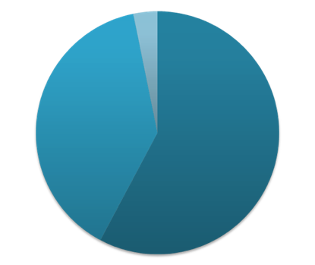
Amazon: The book retail empire
Amazon is an online retailer, not a bookstore
Makes 60% of revenues from sale of non-digital goods
Leader in targeted online marketing
20%-30% of sales comes from recommendations **
Only 16% of people go to Amazon with explicit intent
to buy something **
(** Andreas Weingend, ex Chief Scientist at Amazon)
Digital content powerhouse
670,000 Kindle ebooks with price of $9.99 or less
Music, movies and apps (2011)
Amazon’s core business is retail Amazon revenues, Q1 2012
General Merchandise
Electronics
Computers
Home, Garden & Tools
Grocery
Health & Beauty
Toys, Kids & Baby
Clothing, Shoes
Jewelry
Sports & Outdoors
Automotive & Industrial
Media
Books
Music
Movies
Games
Software
36%
60%
4%
Other services
AWS, credit cards,
other seller sites, …
Source: Amazon

Slide 60



Amazon expertise: Convert engagement into sales The retailing business depends on ‘foot traffic’ to Amazon properties
Recommendations
Traffic to Amazon
Source: VisionMobile
Notes:
>>> updated subtitle

Slide 61











‘Foot traffic’ acquisition strategies ’foot traffic’ can be acquired by ads, affiliates, developing apps or subsidizing devices
$$$ - Search ads
Online ads
Traffic to Amazon
$$$ - Referrals
Affiliates
Traffic to Amazon
$$$ - Amazon apps
Smartphone apps
Traffic to Amazon
$$$ - Device subsidies
Subsidized devices
Traffic to Amazon
$$$ - Revenue share
OEM as affiliates?
Source: VisionMobile
Traffic to Amazon
Notes:
Paid $118M to Google in Jan-Sep 2011 in US alone

Slide 62
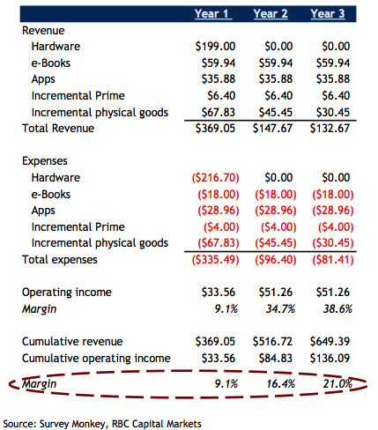
How Amazon makes money
Lifetime value of Kindle Fire buyer
Initial loss on the hardware
But positive margins from year 1
Notes:
>>> Hide slide for now
http://www.trefis.com/stock/amzn/articles/99359/kindle-fire-lifetime-value-should-give-investors-cheer-heading-into-q4-results/2012-01-20

Slide 63



Kindle is the launchpad for the Silk browser Silk will convert OEMs into Affiliates and drive Amazon’s consumer intel
Silk browser allows Amazon collect user click-stream and use them to boost Amazon’s core business
Deeper customer intelligence allows Amazon to target customers more effectively, maximize margins, and improve customer conversion (and sales).
Silk turns the browser into Amazon's retail ‘shelf space’
Silk can be used to deliver targeted Amazon ads directly within the browser UI, saving hundreds of millions of dollars in advertising.
To expand Silk install base Amazon needs to push the browser into more subsidized devices
A new business model will emerge where telecom is used as a complement to online retail business.
By driving the price of telecom products down using subsidies, Amazon can stimulate user traffic to its retail properties.

Slide 64
Three surprising things Amazon might do
Launch an Amazon-branded, subsidized smartphone
Attract operators with the lower data traffic requirements of the Silk browser
Will increase Amazon’s opportunities to drive ‘foot traffic’ to its retail properties
License out the Silk browser to OEMs
OEM becomes Amazon Associate by a classic affiliate marketing model
Amazon extends its reach and can drive more traffic to its retail operations
OEM gains an additional revenue stream as a broker of Amazon ‘foot traffic’
Take over billing relationship for mobile data by bundling costs with content
Today costs of 3G data is bundled into the price of Kindle e-books
In the future Amazon may extend this model to other content types as part of the Amazon Prime subscription service

Slide 65

want more?
“The Kindelization of Tablets” research note published as part of the the VisionMobile
CEO Trendwatch service trends@visionmobile.com

Slide 66

Ecosystems battle across 4-screens
Experience roaming drives user lock-in, cross sales and engagement

Slide 67


Evolving meaning of convergence From converged networks to converged devices, what’s next?
2005
2010
2015
one bill, triple play
one device, 1,000s of apps
?
vision
focal point
network
device
compete based on
price of service
number of apps
Source: VisionMobile

Slide 68

The new meaning of convergence is experience roaming across multiple screens
experience roaming
across screens
 | Social circle
 | Developer ecosystem
 | User data roaming
 | Service roaming
 | User interaction design
 | Industrial design
 | Brand
x
convergence =
Source: VisionMobile
Notes:
>>> Updated title styling

Slide 69

Apple is the poster child of experience roaming Apple leads by example, by delivering a consistent experience across diverse screens
Experience roaming
Across screens
 | Social circle
 | Apps ecosystem
 | User data roaming
 | Service roaming
 | User interaction design
 | Industrial design
 | Brand
Ping
iPod
App Store
iPhone
MobileMe
iPad
iTunes, AirPlay
Mac
iOS
Apple TV
Apple
?
Apple
Source: VisionMobile

Slide 70






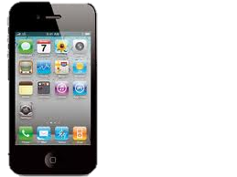
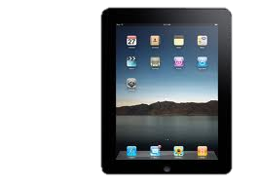
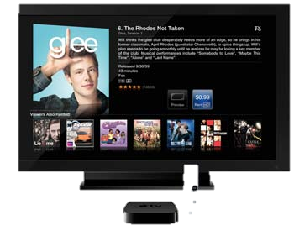
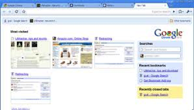
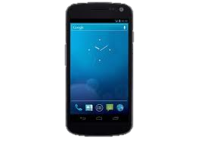
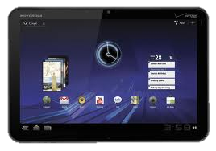
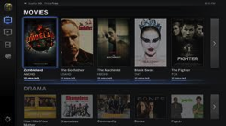


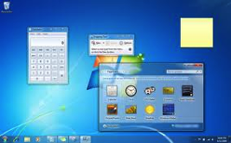
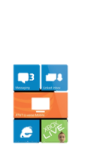
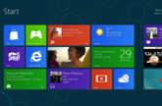

It’s no longer about smartphones Key ecosystems are expanding across 4 screens
PC
smartphone
tablet
smart TV
Mac computers
iPhone
iPad
Apple TV
Chrome browser
Android
Android tablets
Google TV
Windows, Office
Windows Phone
Windows 8
Xbox
Source: VisionMobile

Slide 71





Convergence in 2015 will be around ecosystems and experience roaming across many types of devices
2005
2010
2015
one bill, triple play
one device, 1,000s of apps
one ecosystem, 10s of screens
vision
focal point
network
device
ecosystems
compete based on
price of service
number of apps
experience roaming
Source: VisionMobile

Slide 72
Competition will move to experience roaming competition will shift from number of apps to experience roaming
Mobile platform landscape will further consolidate around Apple and Google both ecosystems are propelled by strong network effects and protected by user lock-in
Microsoft will continue its push to become the 3rd ecosystem faces long uphill battle as it needs to win users back from Apple and Google ecosystems
Facebook will rally behind mobile web to become 4th horse driven by the need to weaken native platforms and disintermediate native app stores
Platform competition will shift from number of apps to experience roaming as all platforms will strive to reach users across all touch-points and devices
Notes:
>>> Add key points from Ben Hookway’s blog (AC todo)

Slide 73
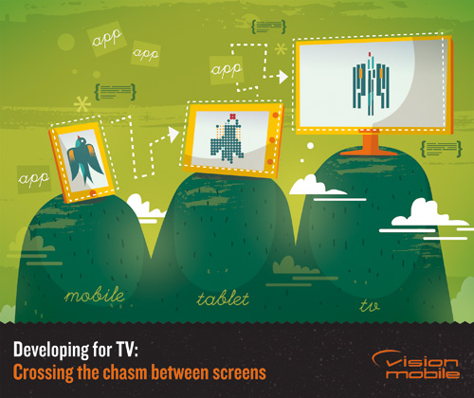
want more?
“Developing for TV:
Crossing the chasm
between screens” article published in the
VisionMobile blog
visionmobile.com/blog

Slide 74

Accessories
The next frontier for platform differentiation
Copyright VisionMobile 2011

Slide 75
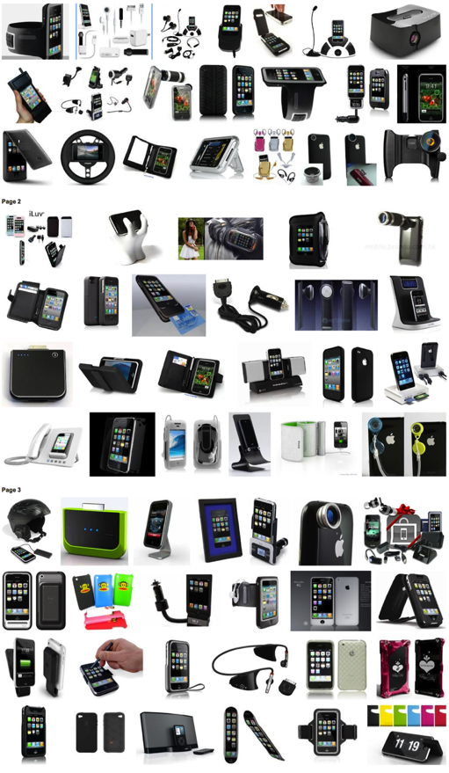
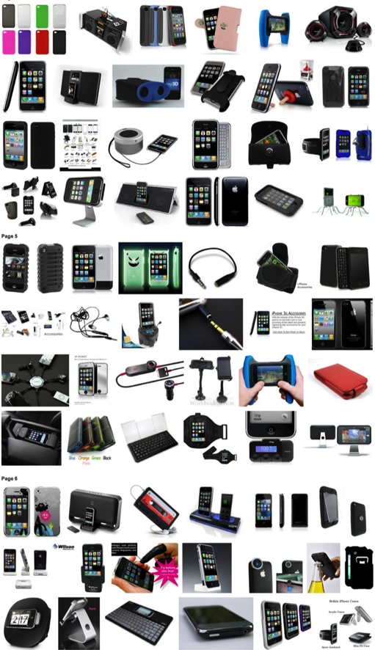
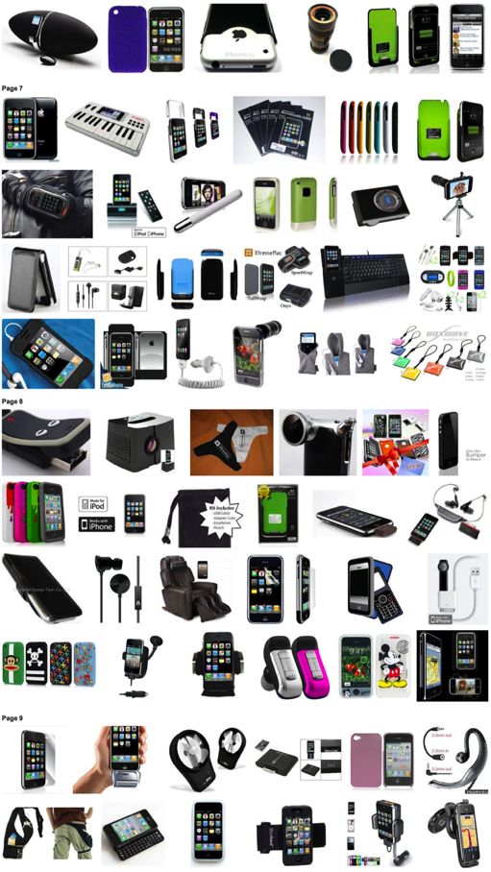
Device accessories were a $32B market in 2011
Source: ABI Research

Slide 76




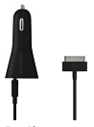


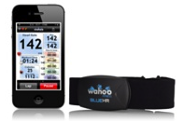

Device accessories are the ‘local cloud’ Extend utility of the device directly adding value to the platform
Source: VisionMobile
Notes:
>>> Review message based on AC’s early concept

Slide 77
Span multiple categories, price points and popularity levels
iPhone accessories
App enabled / Extras
Armbands & cases
Cables & docks
Car accessories
Headsets
Health & Fitness
Power
Speakers
ASP and popularity across categories
$113
$23
$36
$57
$71
$96
$38
$267
0
1
2
3
4
5
6
7
8
9
10
products in top-20²
Source: VisionMobile
¹ Based on top-seller products listed for each category
² Number of category products listed in overall 20 top-seller accessories
Notes:
>>> Todo: add bubbles instead of $ figures (dollar figures remain, but in smaller font size) → I tried that in previous iteration – ended up with confusing slide because of the large difference in numbers. (AC to try to do)

Slide 78
Accessories drive the platform business the more accessories sold, the more devices are sold, and vice-versa
Source: VisionMobile research

Slide 79










Accessories are a part of iOS economics Accessories create user lock-in, differentiation and revenues for Apple
developers
s/w publishers content retailers internet players
media
buyers
$2B
user engagement
app revenue share
external invest. in apps
$$$
$110B
$8B
$6.2B
users and data plans (indirect)
3rd party accessories revenue (indirect)
subsidies
3rd party accessories revenue share
$38B
iOS platform
$1.8B
accessory manufacturers
operators
premium product experience
$90B on devices
$0.2B on Apple-made accessories
$2.8B on apps
$5.4B on music & video
RED = core business
Figures are 2011 revenue estimates
Source: VisionMobile

Slide 80
Accessories = the next frontier of platform differentiation
Accessories drive the platform business
Accessories drive sales of mobile devices and vice-versa due to networks effects – similar to the network effects created by apps
Accessories create user lock-in
Apple and Google can achieve strong lock-in effects due to the user investment in accessories that are incompatible with competing platforms
Accessories create differentiation for platform owners
Apple has created a strong ecosystem of manufacturers around their proprietary 30-pin interface for iPhone, iPod and iPad devices.
Notes:
>>> updated title
>>> todo (once we have a blog): link to accessories blog

Slide 81

Reinventing the telco
Unbundling the telco to compete in the software era

Slide 82

Traditional telco – an all-in-one business from the 90’s designed around tight vertical integration and rigid, inflexible processes
large scale
99,999% reliability
2
Optimised for reliable delivery of few connectivity services at large scale
1
Distribution and retail
Telephony
Messaging
Billing
User identity
Authentication
Consumer intelligence
Designed as a connectivity business with high CAPEX and OPEX
3
take-all-or-nothing: services are tightly coupled to the network
Source: VisionMobile

Slide 83


… but the basis of competition in mobile has changed from reliable delivery of a few services to flexibility and customization
2000’s
today
reliable delivery of few services
choice, flexibility, personalization
basis of competition
apps/ use cases
4 apps (voice, text, contacts, camera)
600,000+ apps (app store and web browser)
telco differentiation
network coverage, speed
price (commodity)
key control point
network
app store
83
Source: VisionMobile

Slide 84
Alternatives emerged due to need for flexibility
Lack of agility due to vertical integration of telcos spawned alternatives
Operator asset | OTT alternatives
Distribution and retail | Apple physical retail stores and digital App Store
Telephony | Skype, Viber, TalkBox, Tango
Messaging | Whatsapp, KakaoTalk, iMessage, Samsung ChatOn
Billing and settlement | iTunes, Google Wallet, FB credits, Amazon 1-Click
User identity & profile | Facebook, Google, Apple ID
Termination | Available on modern smartphone platforms
Consumer intelligence | Distimo, Flurry, AppAnnie
Lack of telco innovation on key assets like voice or SIM in the last decade

Slide 85
How can telcos compete in the new economics? Telcos are essentially 3 businesses in one
Digital: SMS, portals, app store
Voice: CSR, voicemail
Physical: PoS, resellers, print/TV
OTT: app/service inventory Consumer intelligence
Distribution business
Telephony
Messaging
Billing
User identity
Termination
Services business
Ubiquitous data connectivity
Connectivity business
Source: VisionMobile
85

Slide 86
Unbundling is the only way to avoid commoditisation Expose 3 layers within telco business:
- Deliver user targeting
- Deliver customer intelligence
Distribution business
- Expose voice, authentication, etc
to developers
- Expand beyond regional service
boundaries (e.g. with VoIP)
- Build on network effects by launching social tariffs
Services business
- Price differentiate through device wholesale deals
- Price differentiate
by bandwidth
Connectivity business
Source: VisionMobile
86

Slide 87
Telco need new KPIs and tools to compete in OTT era Measure of success for telco OTT initiatives needs to be user- and revenue cross-over
Connectivity
Voice/text
Distribution
KPI: ARPU
KPI: user reach
VoIP
Social
API
New services
Core business
OTT businesses
Measure of success should be revenue cross-over and user acquisition
Use different KPIs 3-month P&L (core) vs 12-month user reach (OTT)
Internalise software design of control points user ID, billing, call control, QoS
Practice agile product development as opposed to waterfall in core business
Staff with 50% software DNA 50/50 split between telco and internet DNA
New economic tools for evaluating ROI discovery-based planning
Source: VisionMobile
87

Slide 88
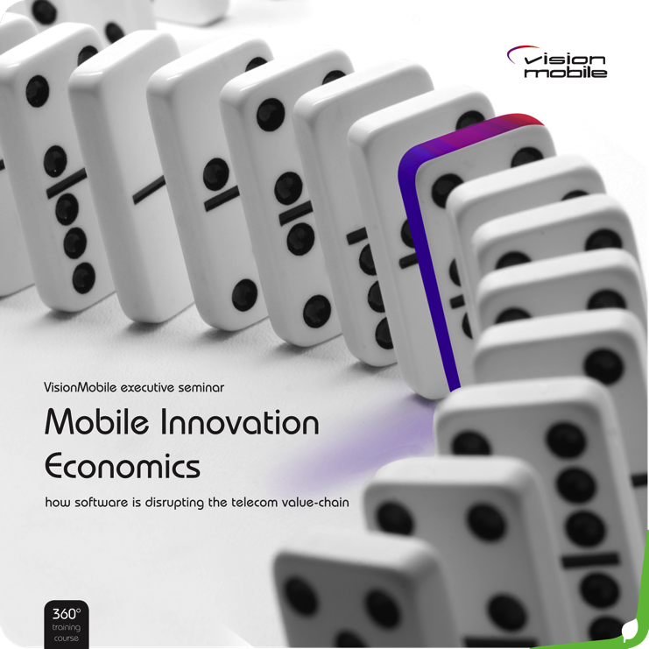
want more?
“Mobile Innovation Economics” strategy workshop on the clash of telco and Internet business models
visionmobile.com/product/mobile-innovation-economics/

Slide 89


The future of voice
From telephony to a diversity of voice use cases

Slide 90










The changing nature of voice communications The choices and types of voice communications are multiplying
2000’s
today
diverse use cases
single use case
dial a phone number,
talk, hang-up
any device to any device
voice transcription
voice messaging
group calling
push-to-talk
user-ID to User-ID
machine-to-user
web-to-phone
anonymous calling
… and more
Source: VisionMobile

Slide 91








Unlocking voice from the confines of telephony by questioning assumptions of the century-old technology
Components of a voice session | Telco approach | OTT approach
Session scope | phone-to-phone | any device to any device
Initiation | phone device | web service or mobile app
Termination | phone number | phone number or username
Transport | private network | public network
Network Architecture | hierarchical | distributed and peer-to-peer
Source: VisionMobile

Slide 92
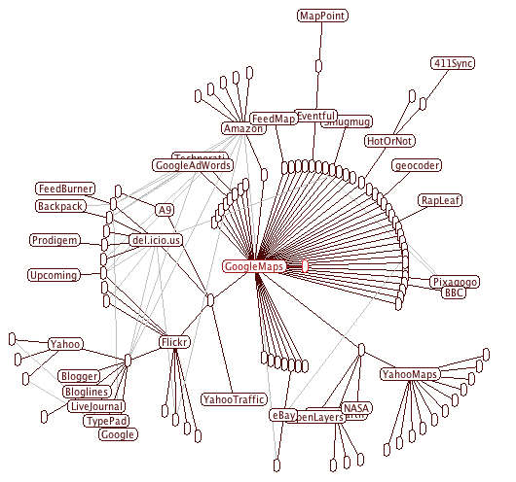












The emergence of voice-second devices and expansion of voice to apps and APIs
voice is blended into web and devices
feature phones
smartphones
voice = phone
voice = app
voice = API
Source: VisionMobile
Notes:
In that case, “voice” is not necessarily telephony
Voice has become “Just Another App”
You can now choose to replace your phone dialer with cheaper/free alternatives

Slide 93



Voice as a killer API for mashups
All-time top API for mashups

Slide 94


Voice API mashups blend voice into new use cases ifttt.com allows creation of API mashups without coding
ifttt.com users created over 450 recipes mashing up phone calls with a host of Internet services:
Source: IFTTT

Slide 95
Key takeaways
Telephony has overshot customer needs
It can no longer be improved in a way that is meaningful to customers - the basis of competition will shift from quality and reliability to flexibility of communication in multitude of use cases beyond telephony. Users will evaluate services based on the breadth of use cases available, not on traditional quality metrics.
Internet telephony is low-end disruption to the telco business model
Less demanding customers accept lower quality for a lower price, often free
The reinvention of voice enables new markets
Century-old assumptions of telephony are challenged and voice will be reinvented as new applications that are no longer recognizable as phone calls
Unbundling of voice is inevitable
The post-disruption value system will unbundle voice from the network on which it travels to unleash innovation of voice use cases and applications.
Notes:
>>> new slide

Slide 96

want more?
“The Future of Voice” research note published as part of the the VisionMobile
CEO Trendwatch service trends@visionmobile.com

Slide 97
get in touch
Knowledge. Passion. Innovation.
andreas@visionmobile.com
@andreascon
Andreas Constantinou | Managing Director | +44 2033 844 163
Updated: 12 November 2010
Copyright VisionMobile 2011

